Slide 1
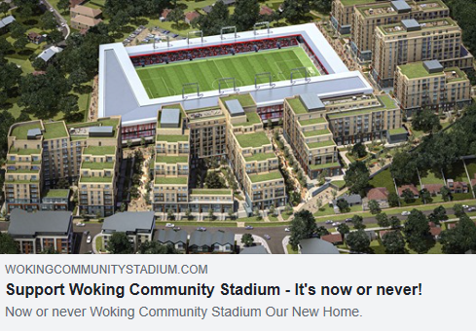
MASSIVE OVER-DEVELOPMENT

Slide 2
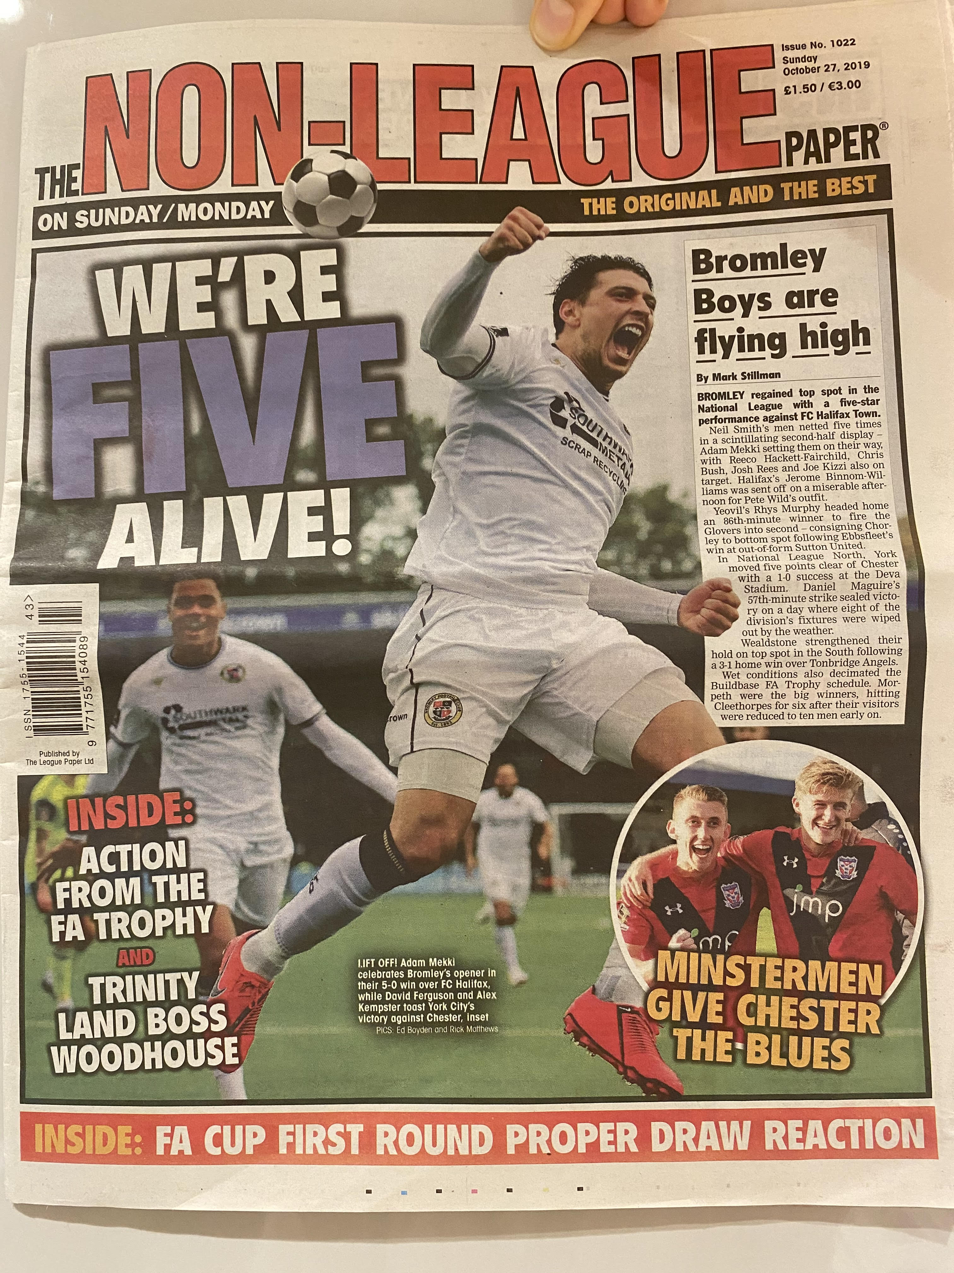
‘NOW OR NEVER’ CAMPAIGN IS DEVELOPER PR SPIN, NOT SUPPORTED BY WOKING FC CLUB CHAIRMAN QUOTED OCTOBER 2019 NON-LEAGUE PAPER

Slide 3
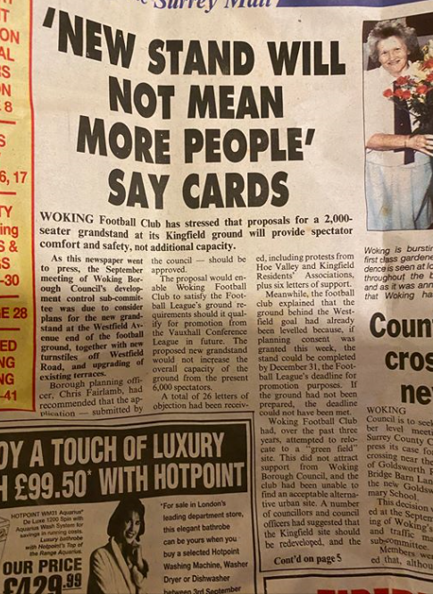
Lack of evidence to suggest new 50% larger stadium will secure more fans – especially given Covid-19 impact on large public activity. Same argument as the 1990s still applies!

Slide 4
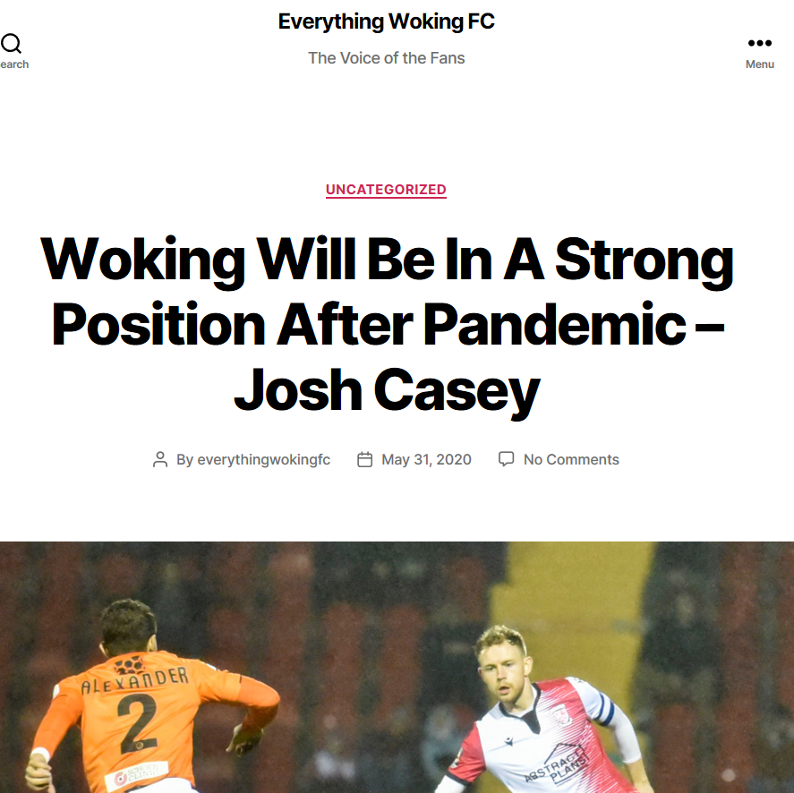
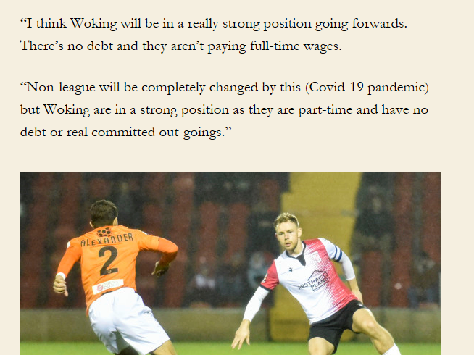

Slide 5
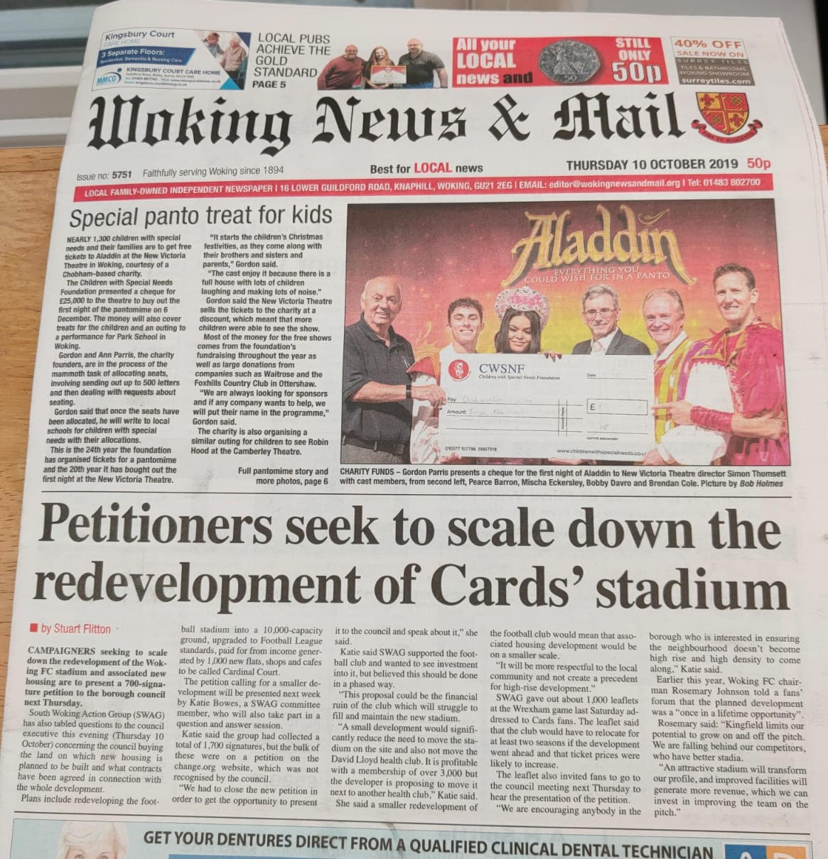
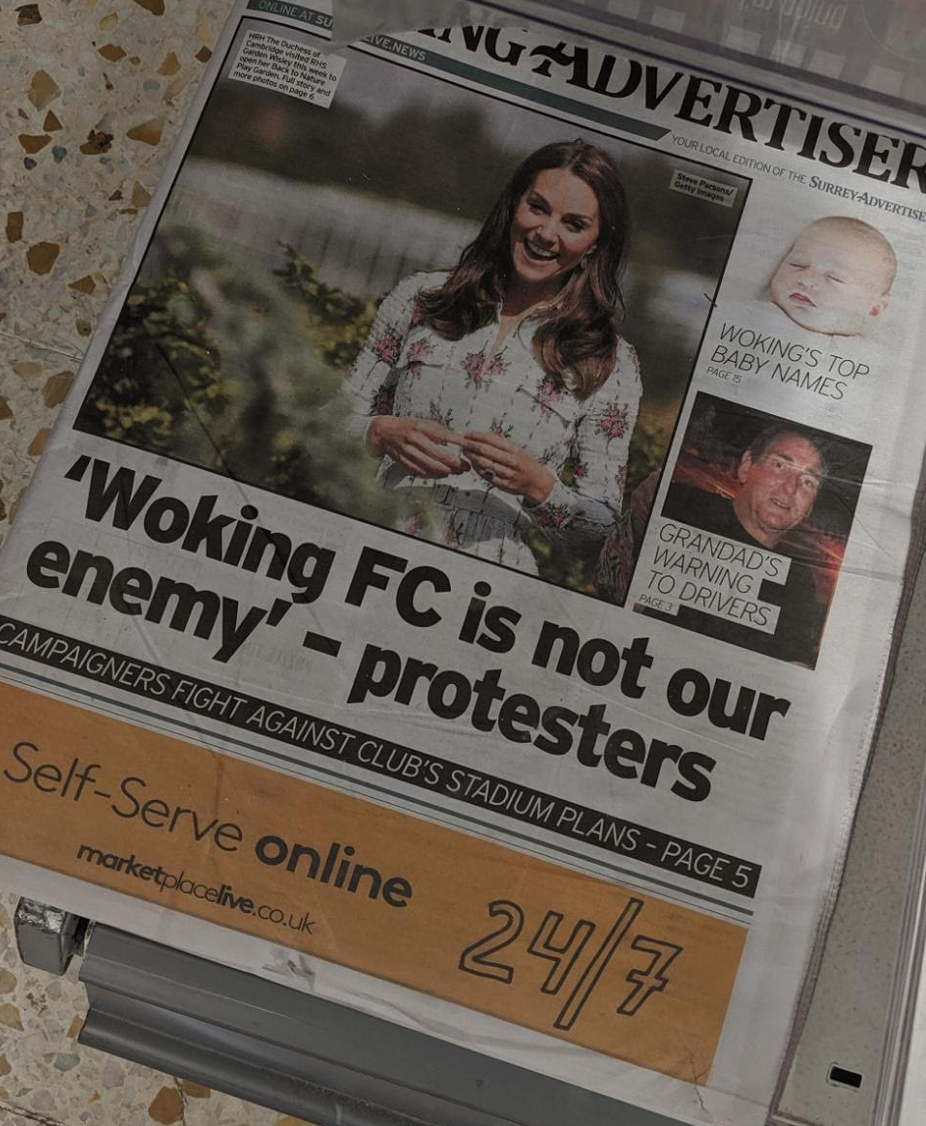

Slide 6
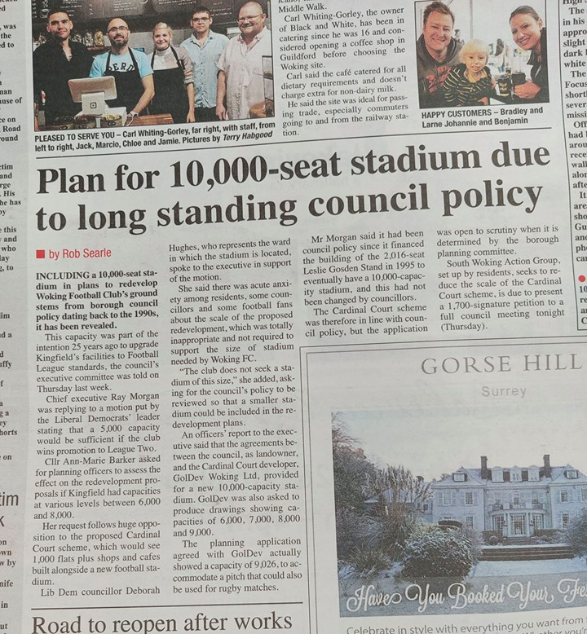

Slide 7
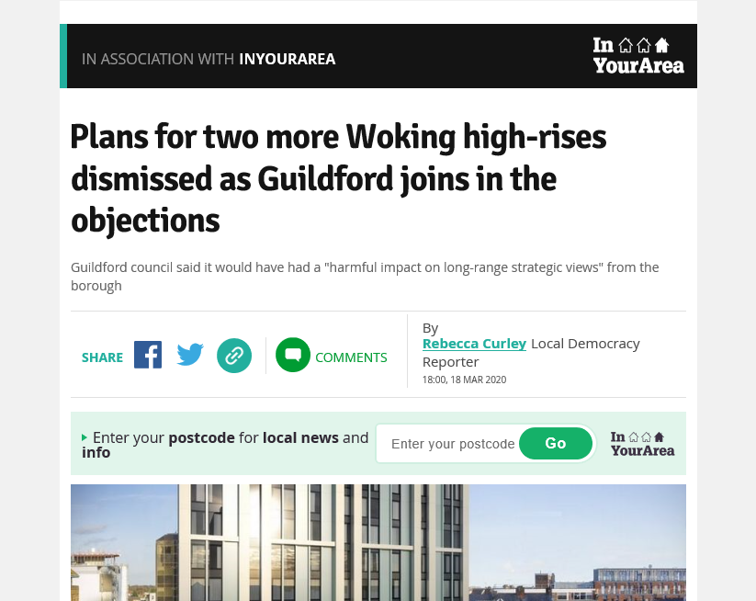

Slide 8
FULL COUNCIL MOTION SUPPORTED TO RE-ASSESS THE NEEDS OF WOKING FC AND THE COMMUNITY OCTOBER 2019 HOE VALLEY RESIDENTS DISAPPOINTED TO SEE THIS WAS NOT DONE IN ANY OBJECTIVE AND COMPREHENSIVE WAY TO JUSTIFY FACILITATING A £250M LOAN AND THE APPLICATION PROCEEDING HOW MUCH ARE WBC GOING TO HAVE TO FUND BUILD THE STADIUM ITSELF?

Slide 9
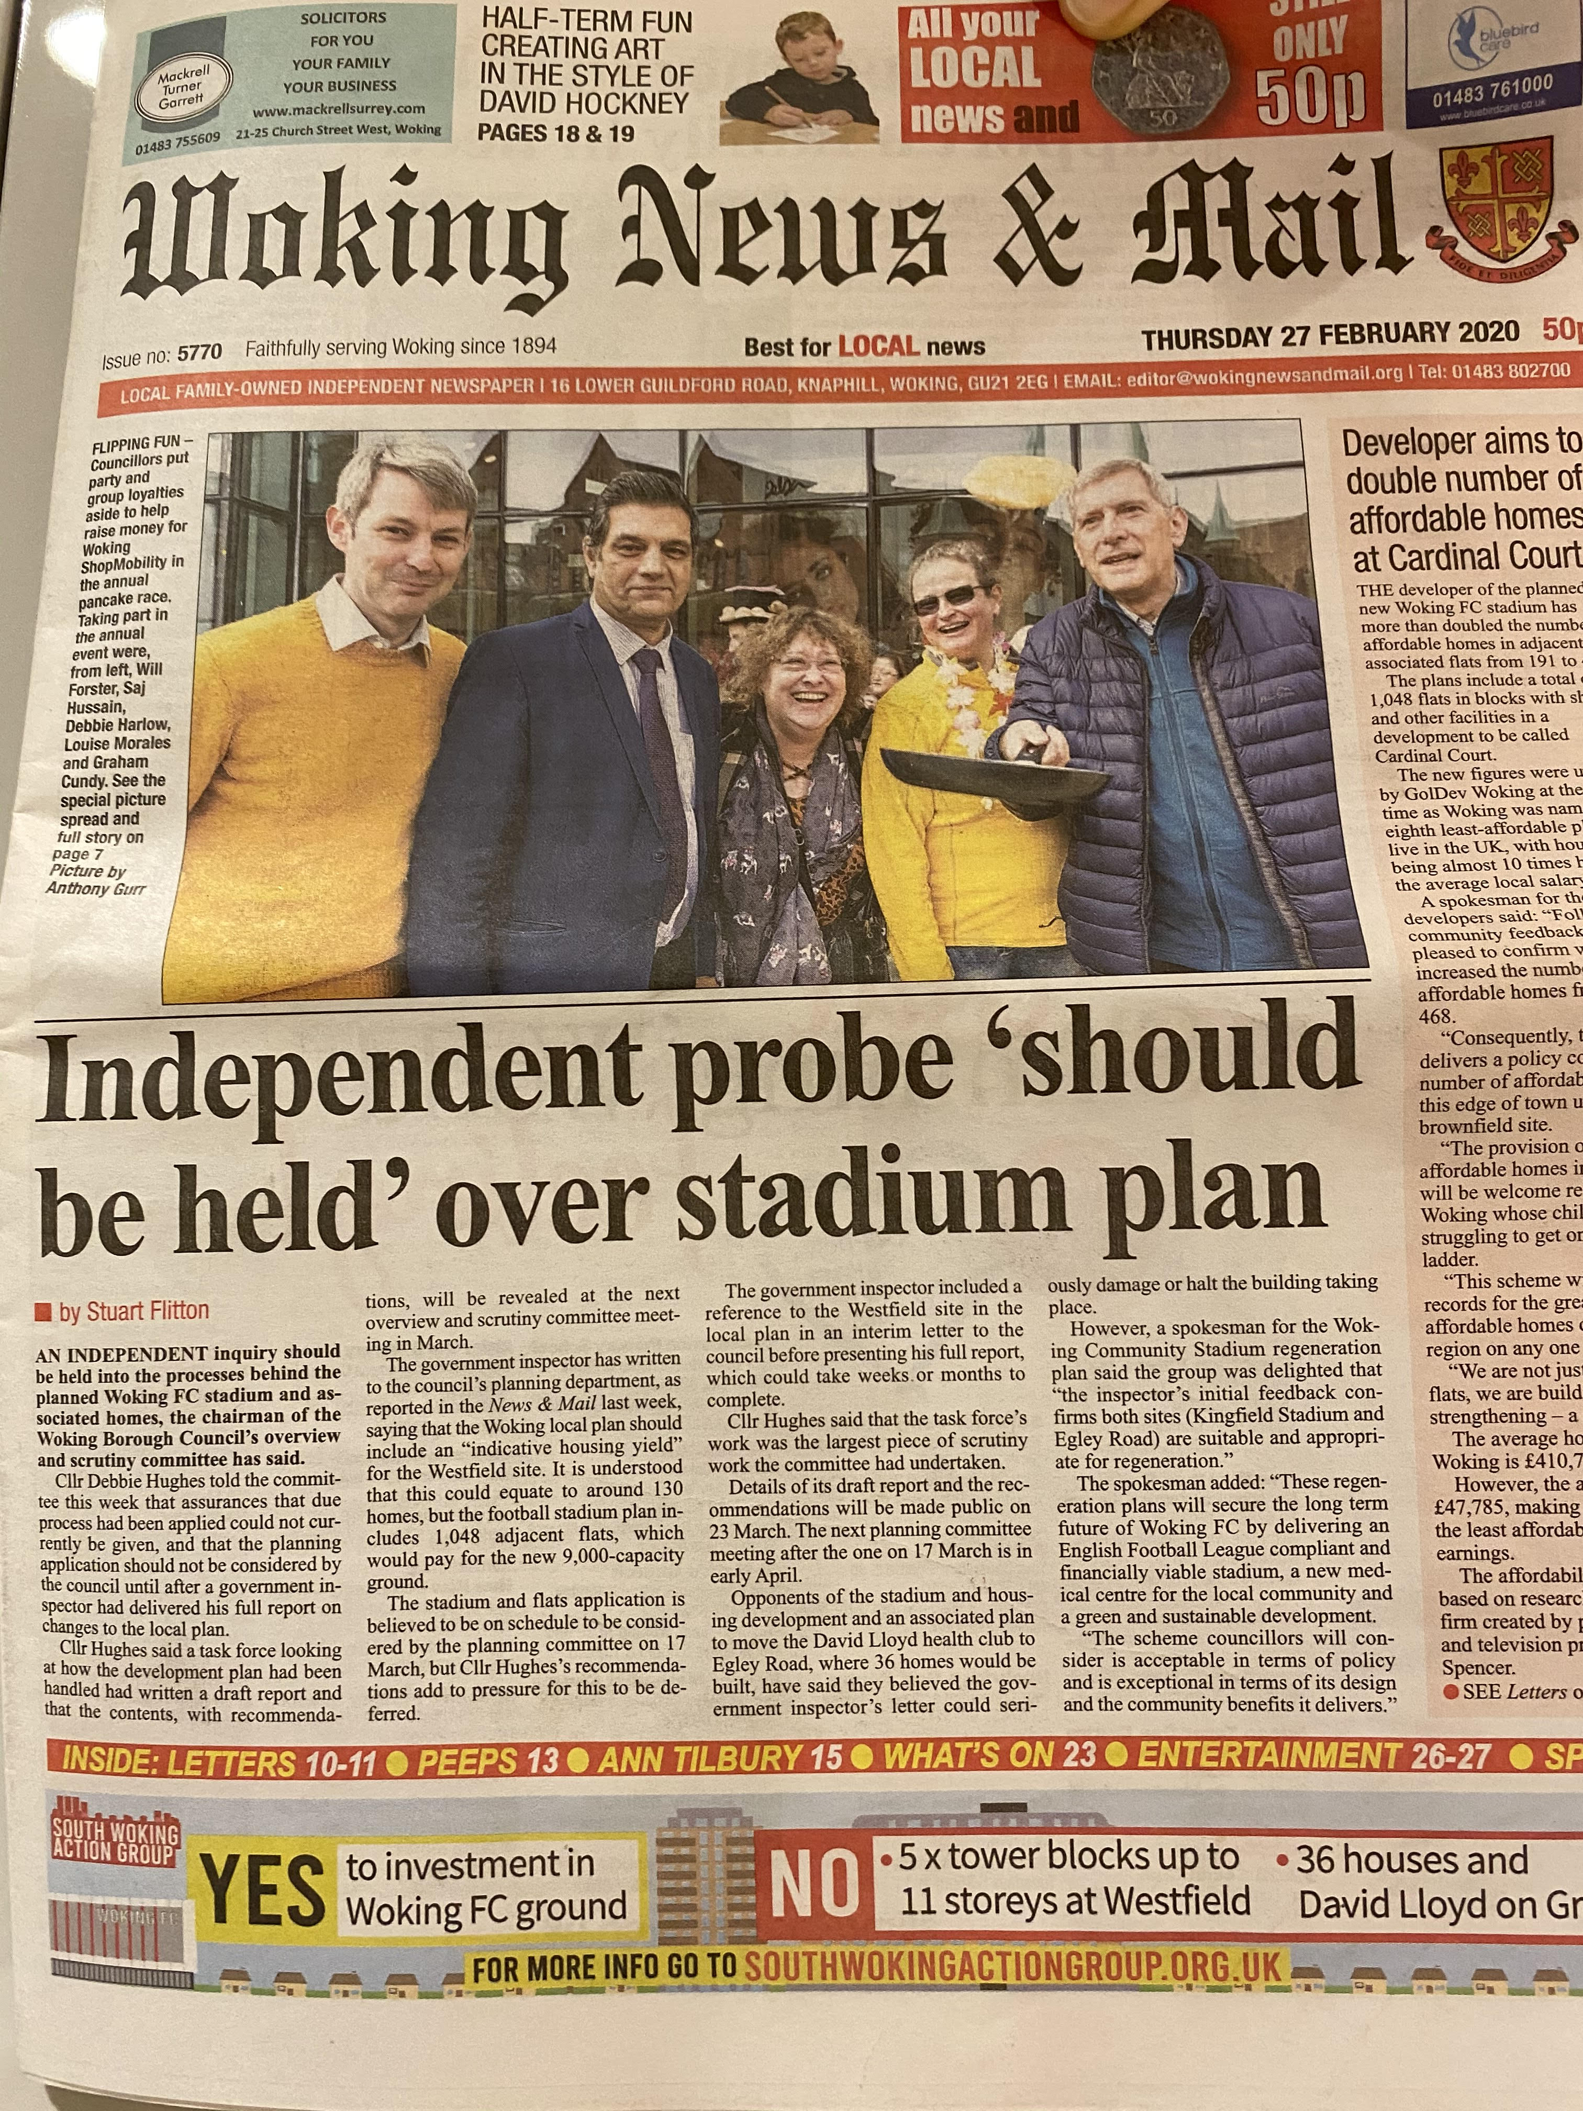
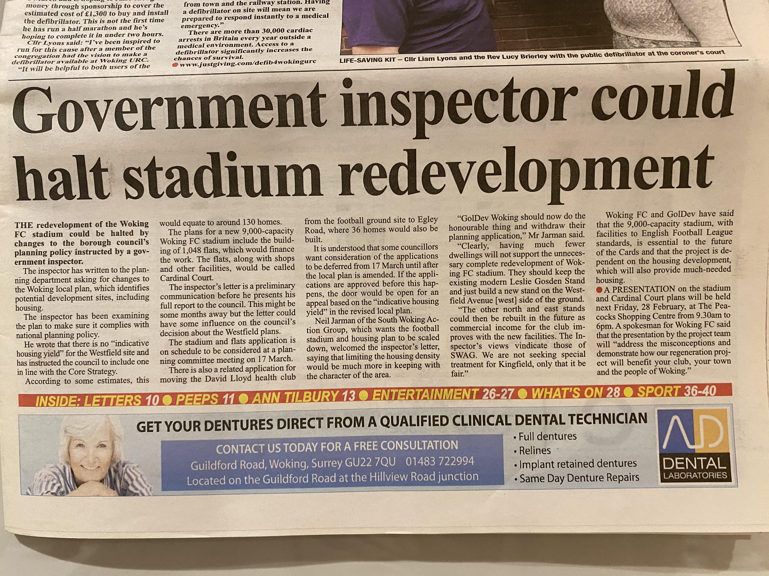

Slide 10
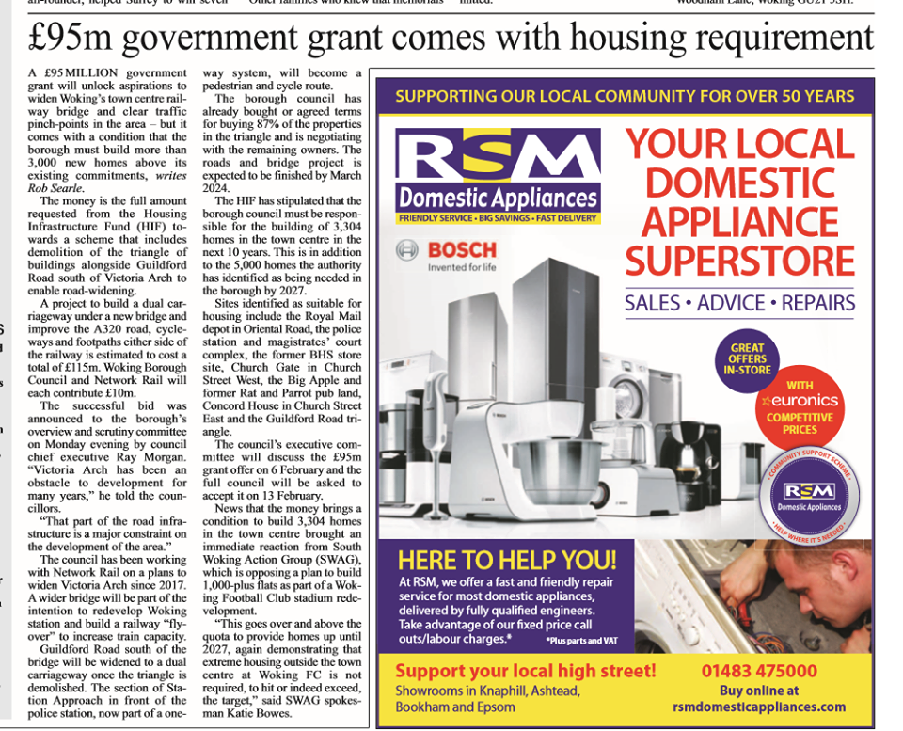
£95M GOVERNMENT GRANT FOR INFRASTRUCTURE, ACCOMPANIED BY HOUSING REQUIREMENT IN TOWN CENTRE, REDUCES NEED FOR OUT OF TOWN CENTRE DEVELOPMENT

Slide 11
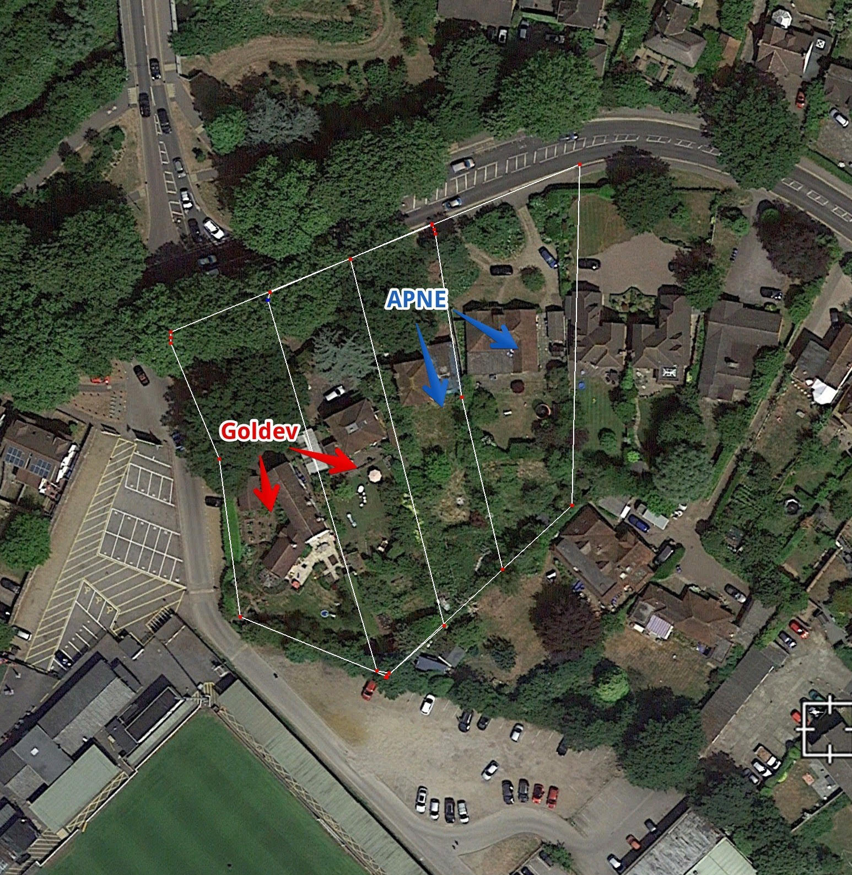
DEVELOPER ALREADY HAS OPTIONS ON HOUSES ALONG KINGFIELD, FACILITATED BY DEALINGS WITH APNE. PROPOSED SITE 6 – 6TH TOWER TO HOUSE MEDICAL CENTRE POST PLANNING ‘APPROVAL’

Slide 12
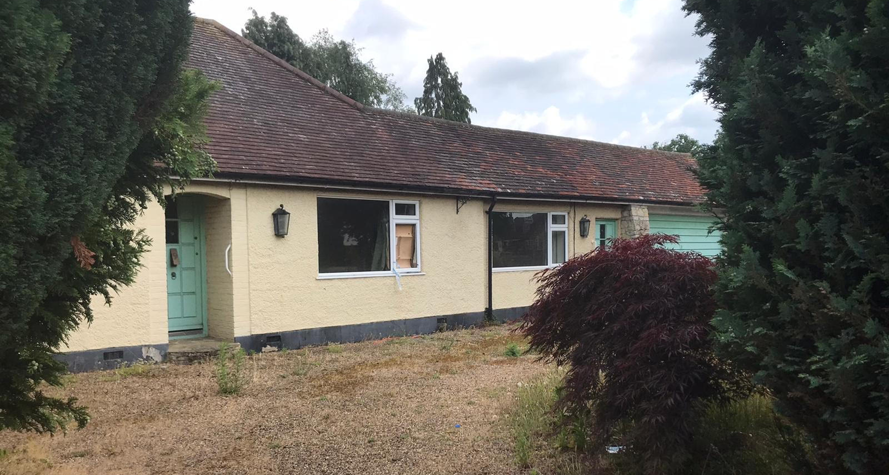
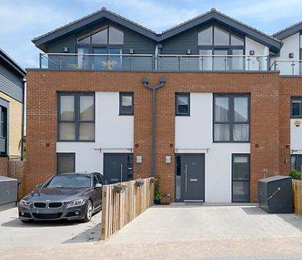
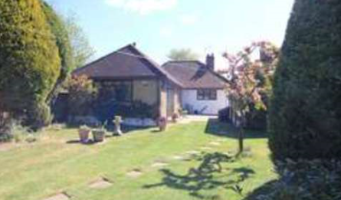
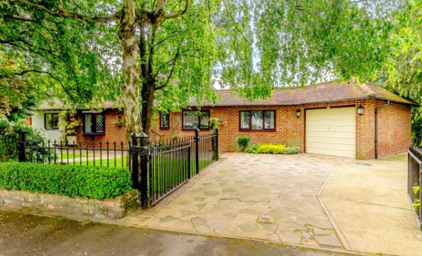
PREVAILING HOUSE SIZE AND CHARACTER OF LOCAL AREA
FAMILY HOUSES
PREVAILING IS 1-2 STOREY WITH GOOD AMENITY SPACE
WILLOW REACH OUTLIER WITH 1 X 5 STOREY BLOCK OF FLATS 80DPH

Slide 13
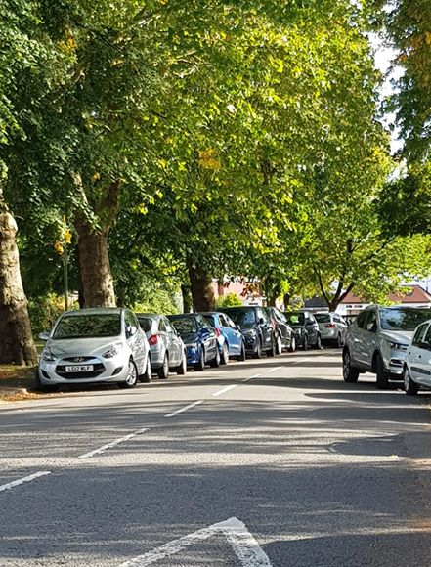
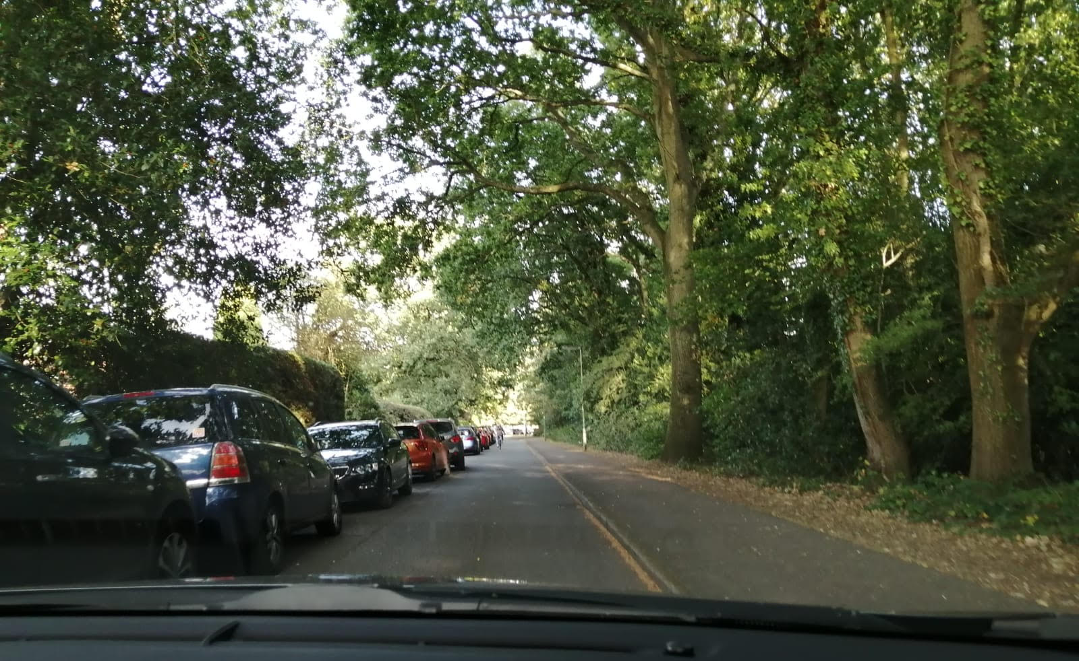
BONSEY LANE AND LOOP ROAD WOKING FC MATCH DAY
PARKING AND CONGESTION WILL BE EXACERBATED BY LARGER STADIUM, FREQUENCY OF USE AND SIGNIFICANT LACK OF PARKING PROVISION

Slide 14
MATCH DAY PARKING WITH AVERAGE OF 1800 FANS….

Slide 15
OFSTED OUTSTANDING NURSERY AND PRE-SCHOOL VITAL ASSET FOR LOCAL FAMILIES – WILL NOT BE
RE-SITED IF PLANNING APPROVED

